Slide 1
FIFA Salary Prediction: A Multi-Method Approach
Ashay Kargaonkar, Kashyap Dobariya, Jose Flores, Komal Shahid, Ian Weimer

Slide 2
Agenda
Introduction
Pre-Processing
Literature Review
Model-Building and Multiple Regression
PCA
CFA
CCA
CA

Slide 3
Introduction
We are going to predict wages of football players.
FIFA 2019 dataset is selected from Kaggle.
It contains 89 columns and 18208 observations.
It contains 2 categorical variable which are used further.

Slide 4
Method
Ashay Kargaonkar | Model building and Regression
Ian Weimer | PCA
Kashyap Dobariya | CFA
Komal Shahid | CCA
Jose Flores | CA

Slide 5
Literature Review
Article 1: "Superstar Effects in Italian Football: an Empirical Analysis"
The paper aims to investigate the determinants of wage using Italian soccer data.
The authors build a model using multiple regression.
Dependent Variable is the natural log of wage.
They find that there is a “superstar effect” that plays a role in determining a players wage.
This effect was measured by taking the number of goals scored and then measuring the number of standard deviations away from the mean.

Slide 6
Literature Review
Article 2: “Salary Determination in the German “Bundesliga”: A Panel Study”
This paper also aims to investigate the determinants of wage using German soccer data.
Paper motivated by increasing salaries soccer players are receiving.
Used multiple regression to model/analyze the data.
The author find age, career games played, international appearances in the current season and last season have the biggest and statistically significant effect on wages.
The author also finds that this effect is non-linear, signifying that there is a “superstar effect” in the German league as well.

Slide 7
Literature Review
Article 3: Computational Estimation of Football Player Wages
This paper also aims predict salary of the player and help clubs for contract negotiation.
Paper tries investigate salary on the basis of performance and the skills of the player.
Various machine learning algorithm were used and compared to get best results.
The author find that overpaid players are physically stronger but lacks some skills like vision, agility, reaction, etc which is possessed by underpaid players.
The author also finds that some players salary predicted is less than actual because other factors like Fans and other factors affect in salary.

Slide 8
Preprocessing
Deleted columns which we think are unnecessary like Name, Nationality, Flag, Jersey Number and many more.
Work Rate was split into 2 columns and changed their categorical values to numerical.
Converted height from feet and inches to cm.

Slide 9
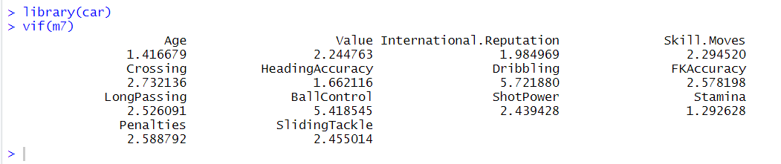
Model Building and Multiple Regression
VIF values were checked and we deleted 5 variables as they were having values more than 10. We came down to 14 variables.
Above table shows VIF values of 14 variables.

Slide 10
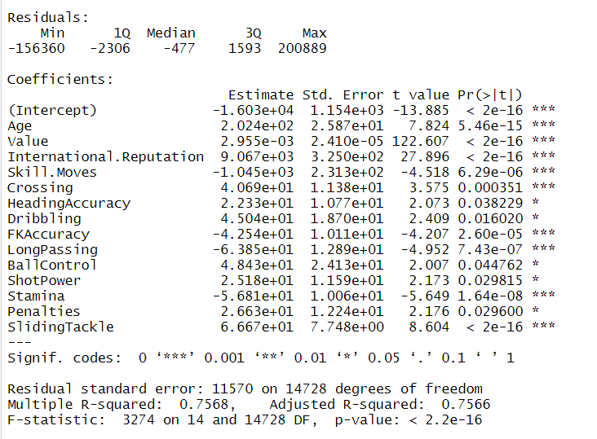
Above image states that:
The model passes the global f-test.
All variables also passes individual t-test.
Multiple R-square value is 75.68%, which is good enough.

Slide 11
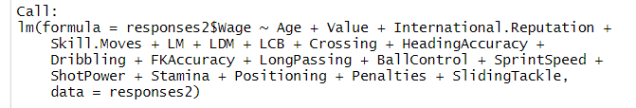
Stepwise regression was applied for “both” direction and we got model which is displayed in above image.
So final 14 variables are Age, Value, International-Reputation, Skill Moves, Crossing, Heading Accuracy, Dribbling, FKAccuracy, Long Passing, Ball Control, Shot Power, Stamina, Penalties and Sliding Tackle.
Among 14 variables 5 variables i.e., Crossing, HeadingAccuracy, Dribbling, ShotPower, Penalties have high beta-coefficient values which states that attackers’ wage is more than a defender or midfielder.

Slide 12

Pre-PCA Steps
Chronbach’s Alpha = 0.8, suggesting good reliability for the dataset
KMO = 0.72, indicating a relatively strong relationship and durable sample size
Bartlett’s Sphericity p < 0.001, can reject Ho, accept Ha: correlations, shared variance between the variables
Conditions satisfied to proceed with PCA

Slide 13
Principal Component Analysis (PCA)
Used to explore our independent variables further, classify groups and get a sense of their contributions to player wage
What characteristics are similar / dissimilar?
FIFA19 data was imbalanced in terms of variance explained, as we have seen in class in other datasets
Slightly higher values reflect three types of variances

Slide 14
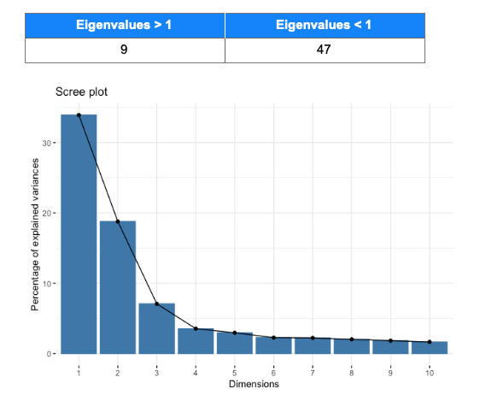
Determining the Component Number

Slide 15
Describing the Components
Component 1 (Attack) - Identified as being strongly associated with positions and skill sets that are related to offensive parts of the game: positions like striker and forward, and skills like finishing and shotpower
Component 2 (Defense) - Identified as being strongly associated with positions and skill sets that are related to defensive parts of the game: : positions like back and sweeper, and skills like marking and tackling
Component 3 (Physicality) - High correlations for attributes like strength and weight
Component 4 (Speed) High correlations for acceleration and sprint speed

Slide 16
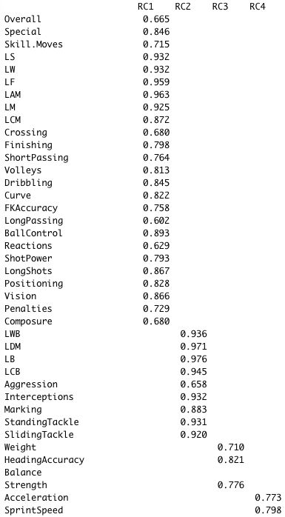
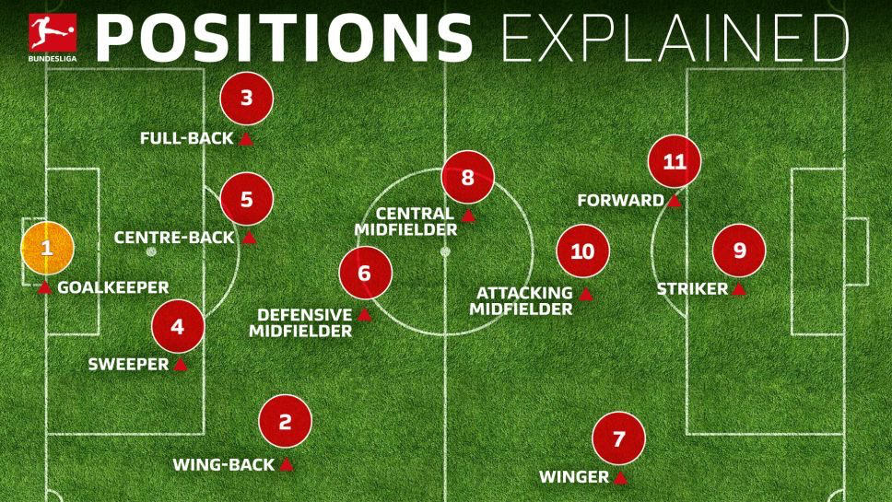
Comparing the Components

Slide 17
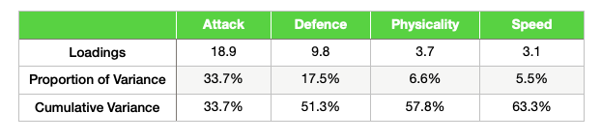
A closer look at Variance
63.3% of variance explained overall, with 4 components
Components 1 and 2 comprise 51.3% of this, which amounts to more than 81% out of the four components
FIFA dataset is a good example of one where fewer components can be used

Slide 18
Exploratory Factor Analysis
Factor analysis applied on the FIFA -19 dataset having 56 variables and 14,744 observations each possesses a player.
Tests:
Cronbach's alpha : 0.81
Kaiser-Meyer-Olkin (KMO) Test for Sampling Adequacy : 0.72
Bartlett's Test of Sphericity : chi-square: 9491.975
p-value < 0.001

Slide 19
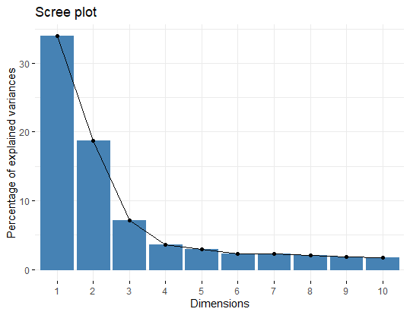
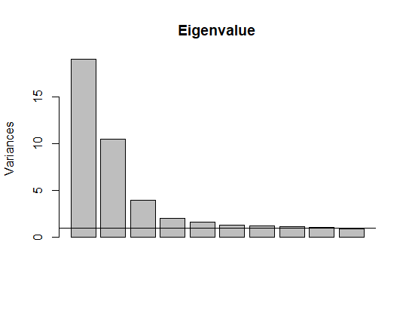
Factors Were determined using two techniques : Scree plot & Eigenvalues

Slide 20
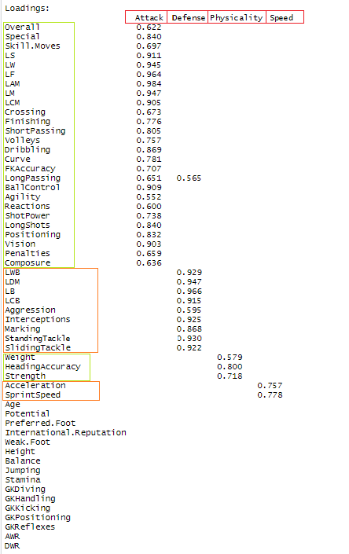
Factor Matrix:
Cutoff is 0.55
Displayed matrix consisted of 4 Factors.
Attack
Defense
Physicality
Speed

Slide 21
Factors Contributing Variance
 | Attack | Defense | Physicality | Speed
SS Loadings | 17.979 | 9.533 | 3.747 | 2.809
Proportion Variance | 0.321 | 0.170 | 0.067 | 0.050
Cumulative Variance | 0.321 | 0.491 | 0.558 | 0.608

Slide 22

Canonical Correlation Analysis -Komal
To figure out number of canonical variables that are highly correlated to players’ value or wage
To predict any new upcoming player’s worth.

Slide 23
CC Analysis
Overall Dataset
Both Offense and Defense
10 variables
Players positioning, tackling, strength, Dribbling, long passing etc.
28 variables
Player’s sprint speed, agility and balance with heading Accuracy.
5 variables.
BALANCE
AND
ACCURACY
POSITION
SKILLS
OVERALL METRICS
Worth
What's players overall performance? Anything Special? 4 variables.
Players’ Value and Wages
Can we predict player’s value and wage?

Slide 24
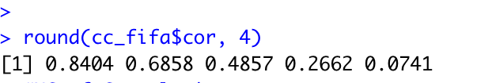
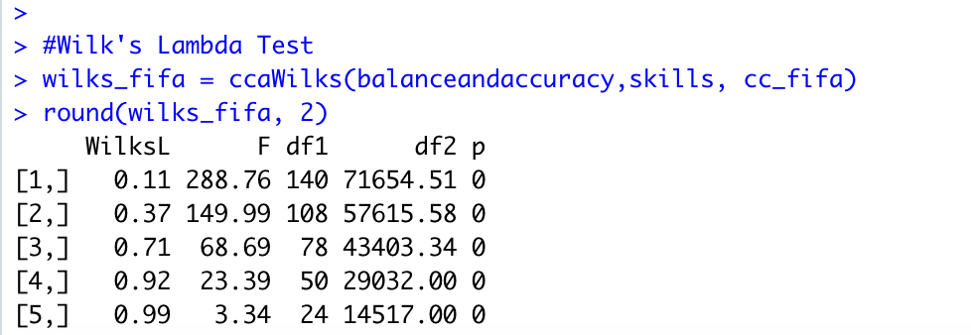
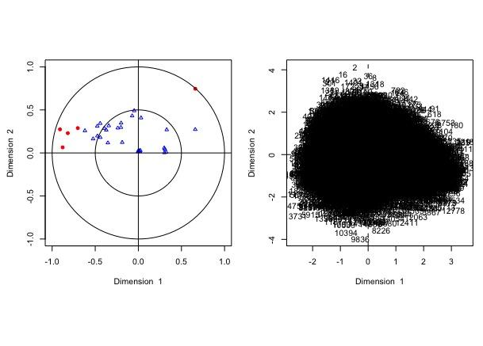
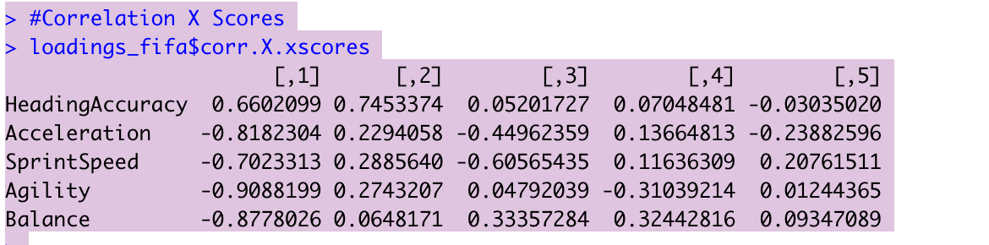
CC Analysis
Skills and balanceandAccuracy sets’ variables association within and in-between datasets
p_value less than .05, so all of the components are significant.
Most of the correlation is in first two canonical variates
Most of the attribute of these two datasets are negatively correlated to each other.
Cc plot of Skills and BalanceandAccuracy

Slide 25
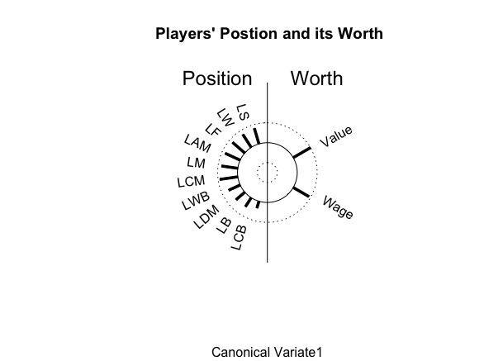
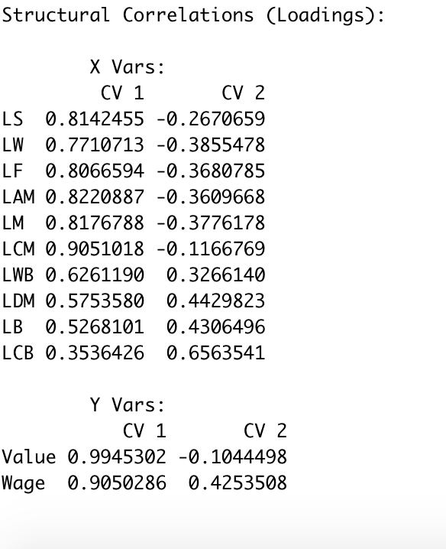
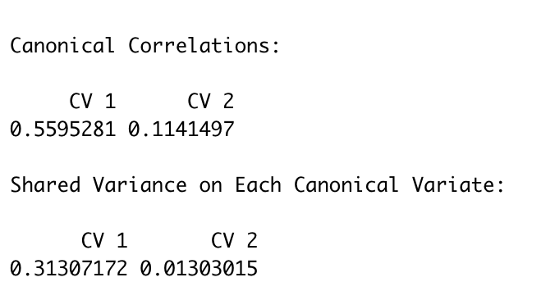
CC Analysis
find the correlation between players’ positions and it's worth
If there are positions that share the most correlation and would be helpful towards predicting players income.
Canonical variate 1 gives us the most information
Positions are highly correlated to players’ worth.

Slide 26
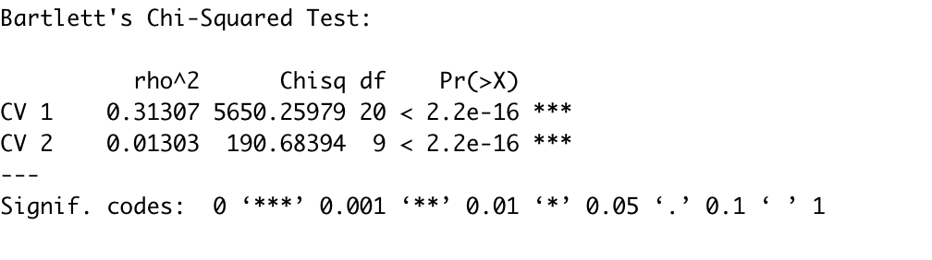
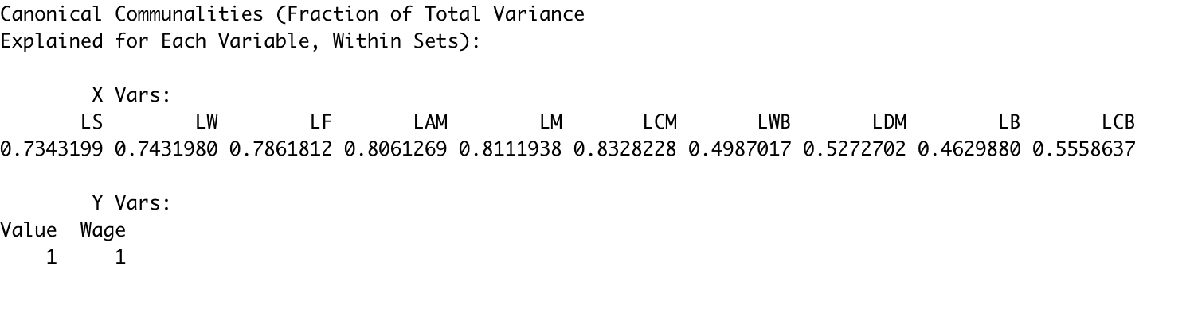
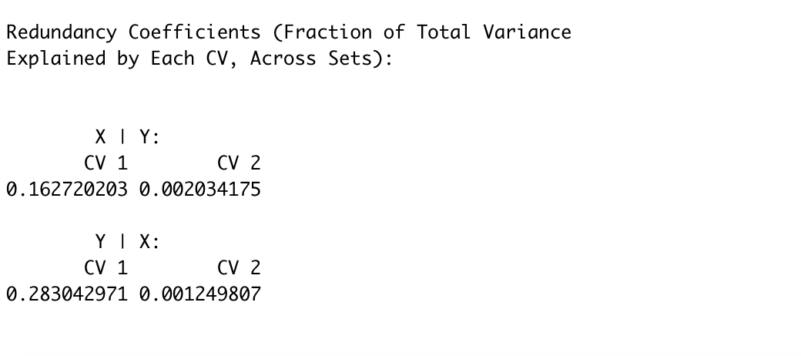
CC Analysis
Bartlett's Chi-Squared Test: for its significance , both seems to be significant.
Who has the most variance explained with in each set.
Does our independent variable explain our dependent or vice versa? how much?
28% of worth is explained by players’ position.
we would be able to drive something new from the given sets of variables or not.
LAM, LCM and LM are the most highly correlated variables within position and to players worth.

Slide 27
Correspondence Analysis
Mostly done as an exploratory tool
Could provide some interesting insights about our data.
Nationality and Team were chosen for analysis.

Slide 28
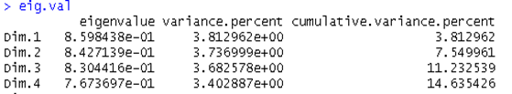
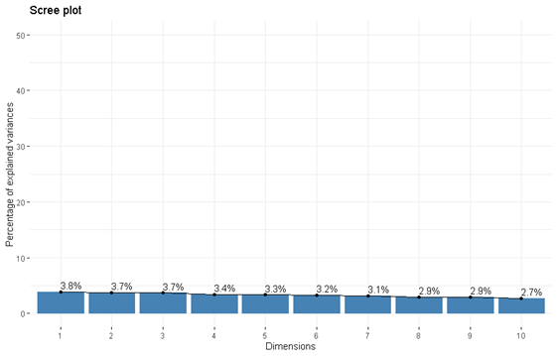
Correspondence Analysis

Slide 29
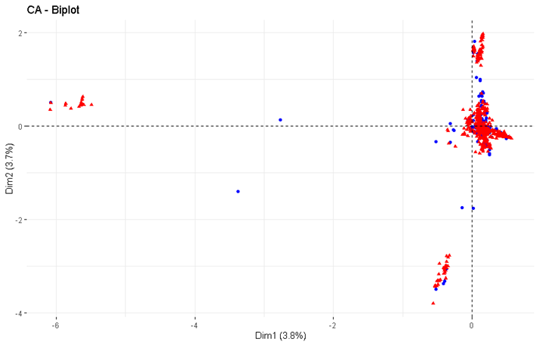
Correspondence Analysis

Slide 30
Some Takeaways
•The outliers are China, Uzbekistan and Hong Kong.
•Depending on what country you are from might hinder your ability to make it to a big soccer league.
•There is a Chinese soccer league (red cluster far left), but wages there are not as high as other leagues.

Slide 31
Conclusion
Using multiple regression we found out of 86 variables 14 are significant in predicting wage of fifa players. As per our analysis players who play on attack side tend to earn more as compared who plays on defense side.
By applying exploratory factor analysis and principal component analysis it can be interpreted that most of the players can be divided into 4 groups Attack, Defence, Physicality and speed.
For CCA, we concluded that LCM, LM and LAM from position dataset were highly correlated to players income and value. Also, having some of the variables in players’ skills set not being correlated at all to the other sets, we can say that position gave us the most information and correlation to our research.
In conclusion, CA proved to be inefficient at showing a link between Nationality and team. Each dimension explained roughly the same amount of variance indicating that more pre-processing must be done to the data however that is beyond the scope of the paper.

Slide 32
References
Battré, M., Deutscher, C., & Frick, B. (2009). Salary determination in the German Bundesliga: a panel study. In No 0811, IASE Conference Papers, International Association of Sports Economists.
Lucifora, C., & Simmons, R. (2001). Superstar effects in Italian football: An empirical analysis. Università cattolica del Sacro Cuore.
Yaldo, L., & Shamir, L. (2017). Computational Estimation of Football Player Wages, International Journal of Computer Science in Sport, 16(1), 18-38. doi: https://doi.org/10.1515/ijcss-2017-0002

